Slide 1

MARMARA UNIVERSITY
FACULTY OF ENGINEERING
ELECTRICAL & ELECTRONICS ENGINEERING
EE4047 HIGH VOLTAGE PRESENTATION
«MEASUREMENT OF HIGH VOLTAGE WITH SPHERE GAPS»
Muhammed Atabay 150718037
Osman Büyükkağnıcı 150718015
Ferhatcan Dumlu 150717038
Nurullah Said Tüğmen 150720823
Ali Eren Türk 150718016

Slide 2
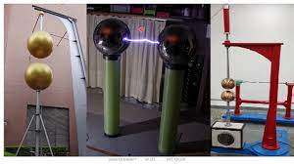
«MEASUREMENT OF HIGH VOLTAGE WITH SPHERE GAPS»
What is the purpose of the test ?
High voltage can be measured in a variety of ways such as capacitive voltage divider, electrostatic instruments and by using breakdown voltage of a sphere gap. The spark over of sphere gaps and other gaps also are used especially in the calibration of meters in high voltage measurements. [1]

Slide 3
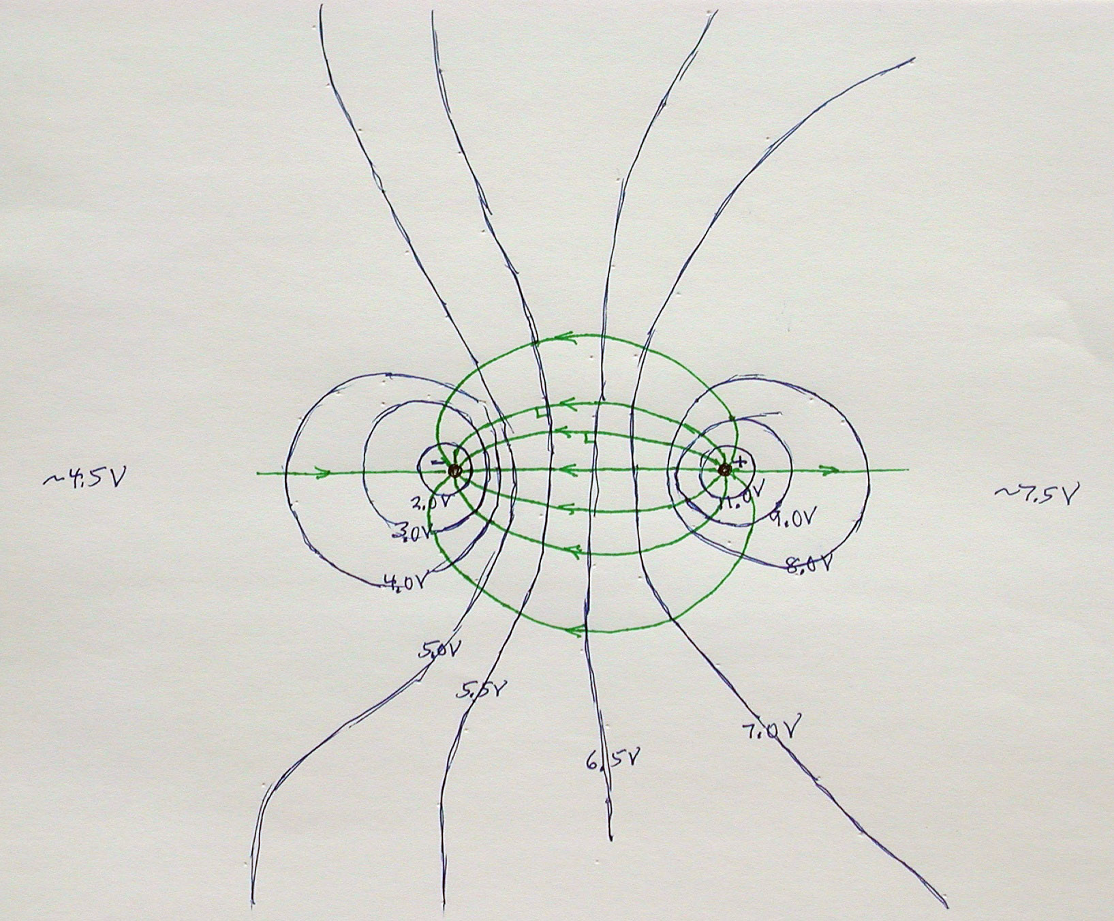
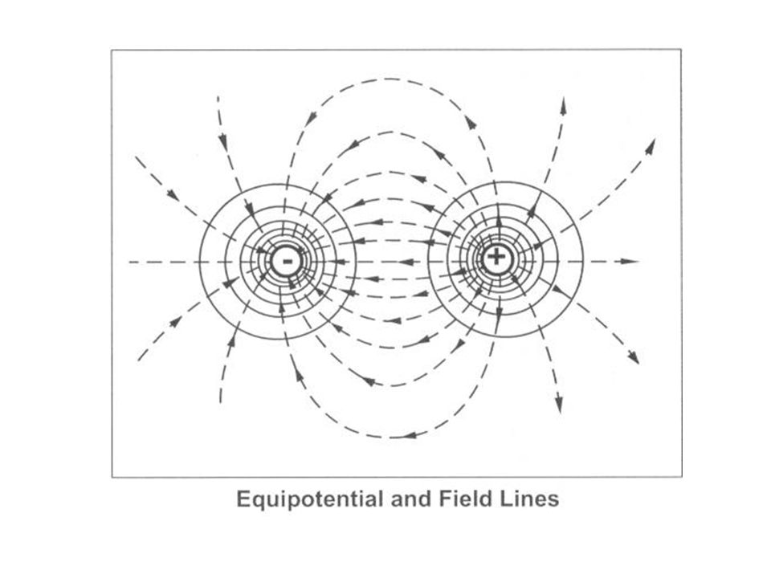
«MEASUREMENT OF HIGH VOLTAGE WITH SPHERE GAPS»
Why is it needed ?
By precise experiments the breakdown voltage variation with gap spacing for different diameters and distances, have been calculated and represented in specific table. Electric potential, or voltage, is easily measured. This phenomenon can be used to map an electric field. [2]

Slide 4
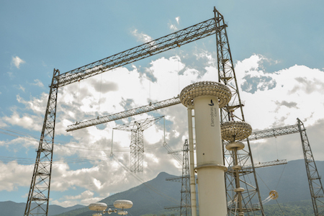
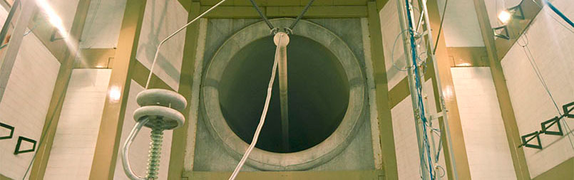
«MEASUREMENT OF HIGH VOLTAGE WITH SPHERE GAPS»
«MEASUREMENT OF HIGH VOLTAGE WITH SPHERE GAPS»
Selected laboratory is Cepel High Voltage Lab.
The lab is in Rio de Jenario in Brazil. It is used for industrial development.
The lab was established in 1974 and High Voltage lab has established in 1979 then the High Power lab was installed in 1981.
This is just active HV lab in Brazil.

Slide 5
The Equıpment usıng ın the test and the setup
The measurement of high voltage with sphere gaps is a technique commonly used to determine the voltage level of high-voltage systems. The test setup typically involves the following equipments:

Slide 6
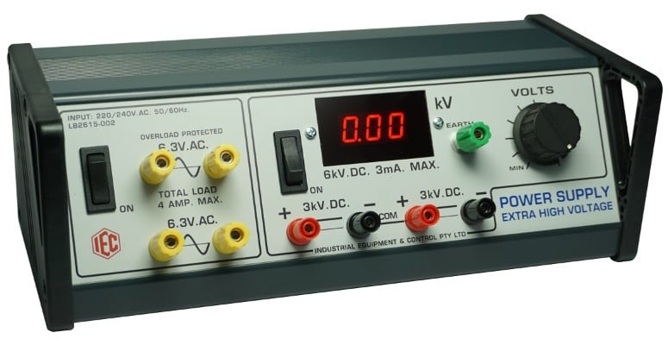
Hıgh voltage power supply
A high-voltage power supply is used to generate the high voltage that needs to be measured. It can be an AC or DC power supply, depending on the application.

Slide 7
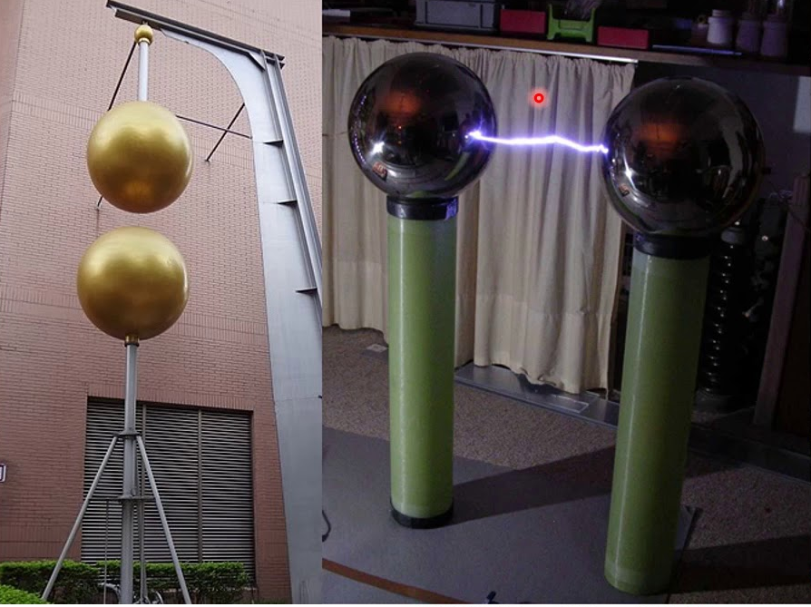
Sphere gaps
Sphere gaps are used as voltage dividers and are an essential component of the test setup. A sphere gap consists of two conducting spheres mounted on insulating supports. The distance between the spheres can be adjusted to create a gap. The voltage across the gap is proportional to the voltage being measured.

Slide 8
Insulators and mounting structers
Insulators are used to support the sphere gaps and prevent the flow of current between the spheres. These insulators need to have appropriate electrical insulation properties to withstand the high voltages involved.

Slide 9
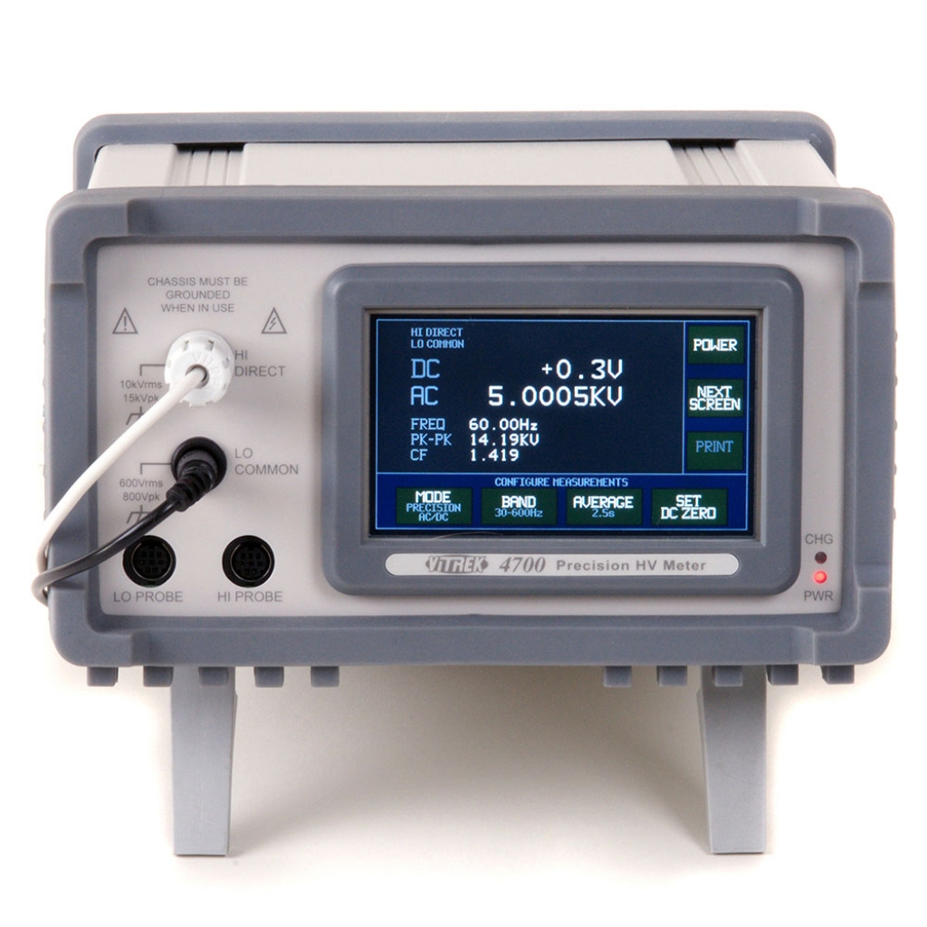
Hıgh voltage mesurıng ınstruments
To measure the voltage across the sphere gaps accurately, high-voltage measuring instruments such as voltmeters or oscilloscopes are used. These instruments should have suitable voltage ratings to handle the high voltages involved in the test.

Slide 10

Safety equıpments
Due to the high voltage levels, safety equipment such as insulating gloves, safety barriers, and grounding systems are essential to protect personnel and equipment from electrical hazards.

Slide 11
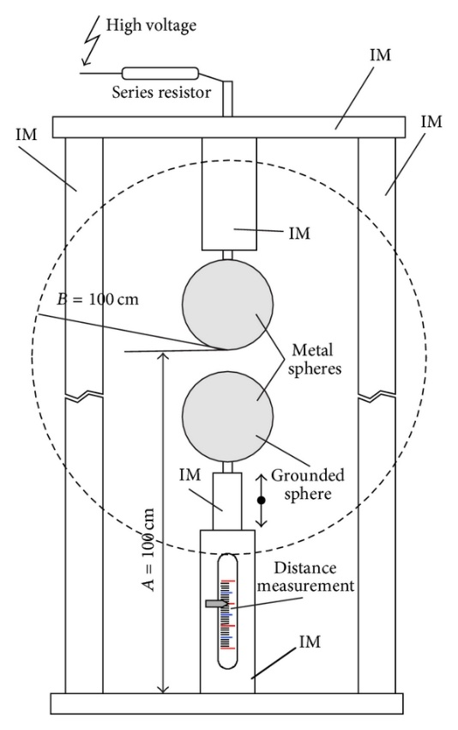
Setup of the system
The test setup for measuring high voltage with sphere gaps typically involves connecting the high-voltage power supply to the sphere gaps. The sphere gaps are adjusted to the desired gap distance, and the voltage across the gap is measured using the high-voltage measuring instruments. The voltage reading is then correlated with the known characteristics of the sphere gap to determine the voltage level of the high-voltage system being tested.

Slide 12
It's important to note that the specific details of the test setup may vary depending on the application and the desired accuracy of the voltage measurement. It is crucial to follow established safety procedures and guidelines when working with high voltages to ensure the safety of personnel and equipment.

Slide 13
What about ın cepel (Centro de Pesquisas de Energia Elétrica)
Cepel is a renowned research center focused on energy in Brazil. They specialize in various areas of electrical power, including generation, transmission, distribution, and use. Their laboratory is equipped with a wide range of testing equipment to support their research and development activities.

Slide 14
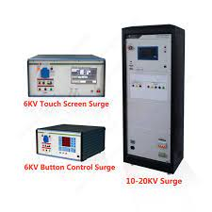
Hıgh voltage testıng equıpment
Cepel's laboratory is likely to have high-voltage testing equipment to conduct various tests on electrical components and systems. They have AC and DC high-voltage sources, transformers, circuit breakers, and surge generators in the laboratory.

Slide 15
Power system sımulators
Cepel has power system simulators to recreate and analyze the behavior of electrical grids. These simulators can replicate various operating conditions, fault scenarios, and transient events to assess system performance and reliability.

Slide 16
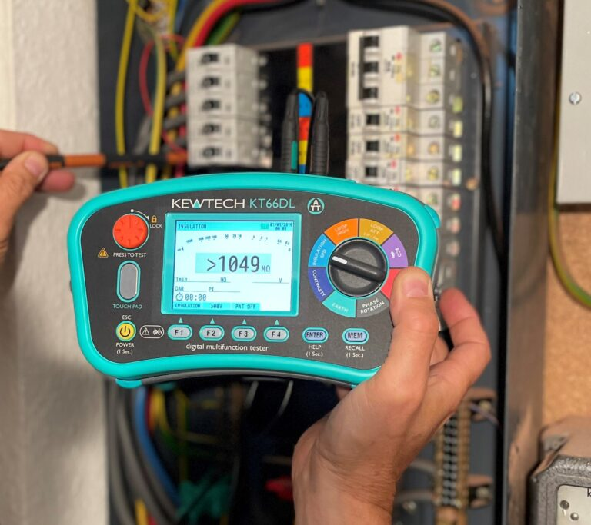
Insulatıon testıng equıpment
Insulation testing is crucial for assessing the insulation properties of electrical components. The laboratory is equipped with insulation resistance testers, partial discharge measurement devices, and other specialized equipment for insulation diagnostics.

Slide 17
Power qualıty analyser
Power quality analyzers are used to measure and analyze various power quality parameters such as voltage sags, harmonics, flicker, and transients. These instruments help in identifying and mitigating power quality issues in electrical systems.

Slide 18
Protectıon and control testıng equıpment
Cepel's laboratory has equipments for testing and evaluating protection relays, control systems, and communication protocols used in power systems. This could include relay test sets, communication analyzers, and signal generators.

Slide 19
capabılıtıes
Ultra HV outdoor laboratory for testing AC/DC transmission lines and electrical equipment and accessories for systems up to 1200kV AC and ±1000kV DC with the following capabilities; Three single-phase 750 kV 60 Hz Voltage transformers for three-phase tests and 2.25 MV AC 60Hz for single–phase tests. DC sources up to ±1.600 kV, Impulse generator for lightning and switching impulse up to 6.4 MV and combined tests.

Slide 20
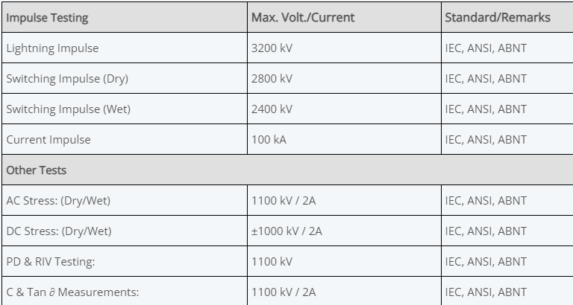

Slide 21
What Cepel do?
Numerous laboratory tests are performed at this facility and some of them accredited by the General Coordination of Accreditation (CGCRE) of Inmetro.
The tests are divided into many sub-titles such as High and Ultra-High Voltage, High Power, Energy Efficiency.

Slide 22
List of Laboratories
High and Ultra-High Power | LabUAT, LabAT
High Power | High Power Laboratory
Field Evaluation | HUNDRED
Energy Efficieny | LabEE, LabAP4, BD Engine
Studies | Transitory
Materials and Mechatronics | LabME, LabMM
Smart Grids | Smart Grid Laboratory

Slide 23
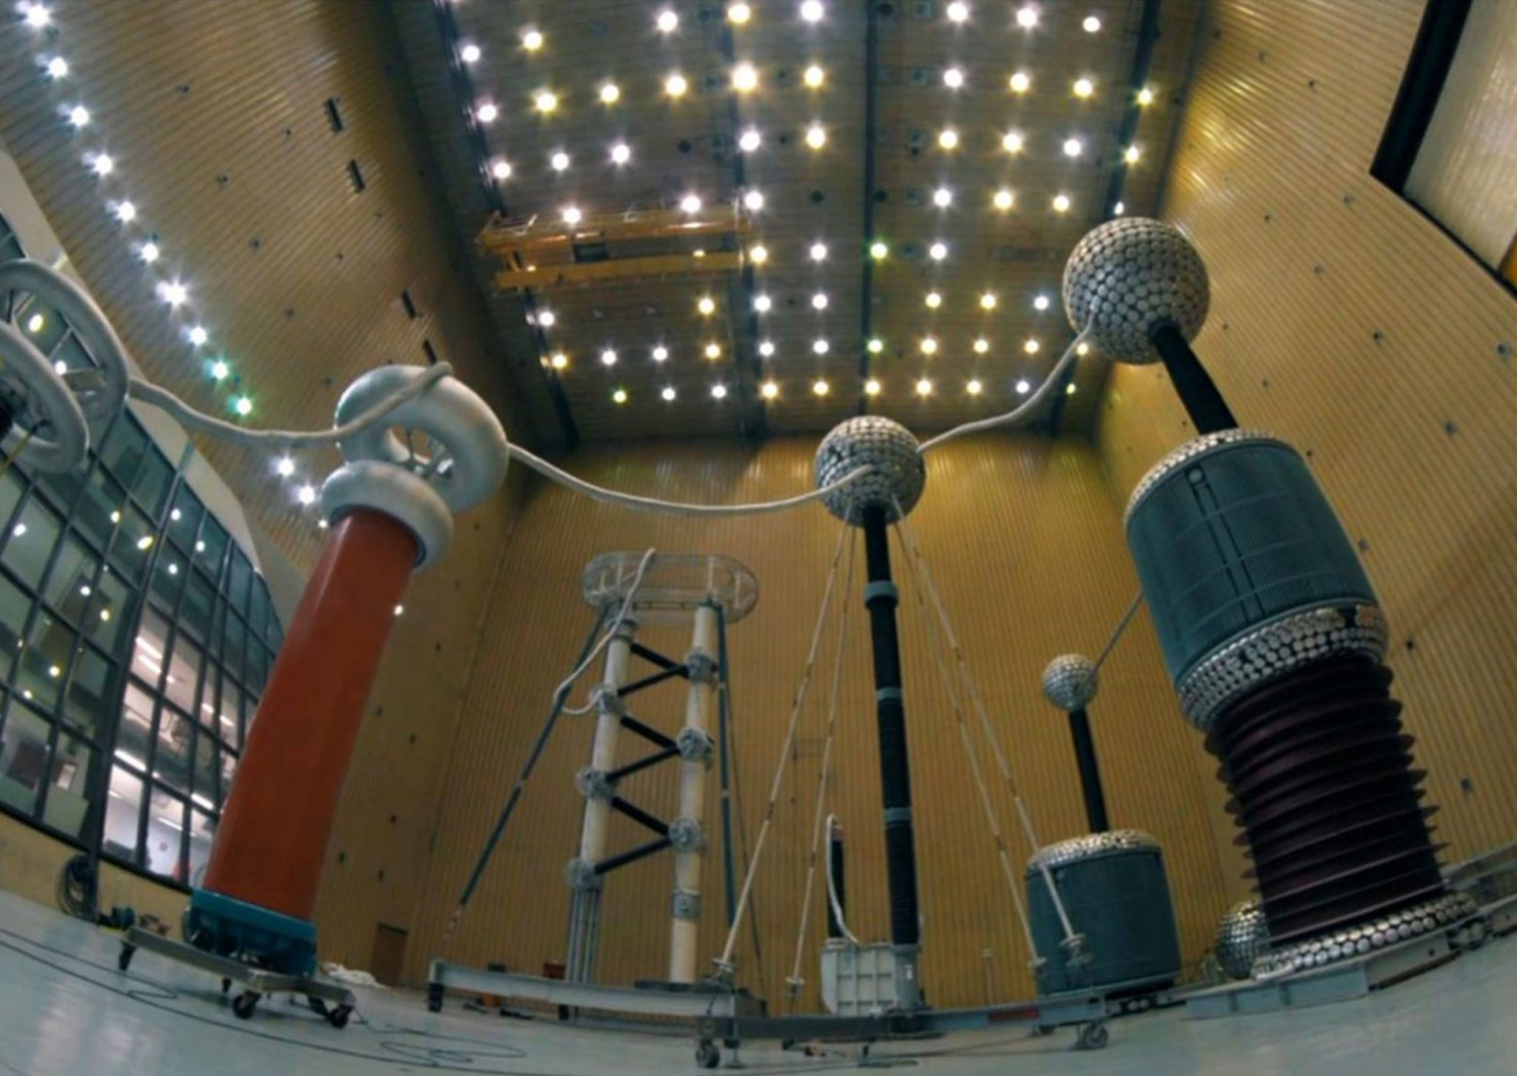
HIGH VOLTAGE LABORATORY (LabAT)
This laboratory is a complex that tests equipment used in distribution and transmission networks.
Equipment tests and research and development experiments are carried out for many distribution and transmission companies in Brazil and South America.
Dielectric tests are performed with alternating voltage, direct voltage or pulse demands.

Slide 24
The main tests carried out in this lab;
Capacitance measurement test and dissipation factor of the insulation,
Partial discharge measurement test,
Maneuver and atmospheric impulse test,
Drilling stress test,
Calibration,
Withstand voltage test at industrial frequency (60 Hz, dry and wet conditions),
Verification tests or determination of insulation supportability.

Slide 25
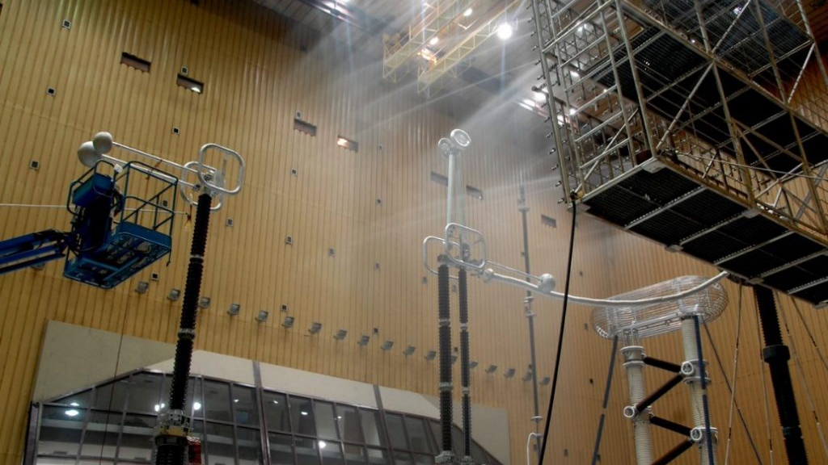
Dielectric withstand test under artificial rain

Slide 26
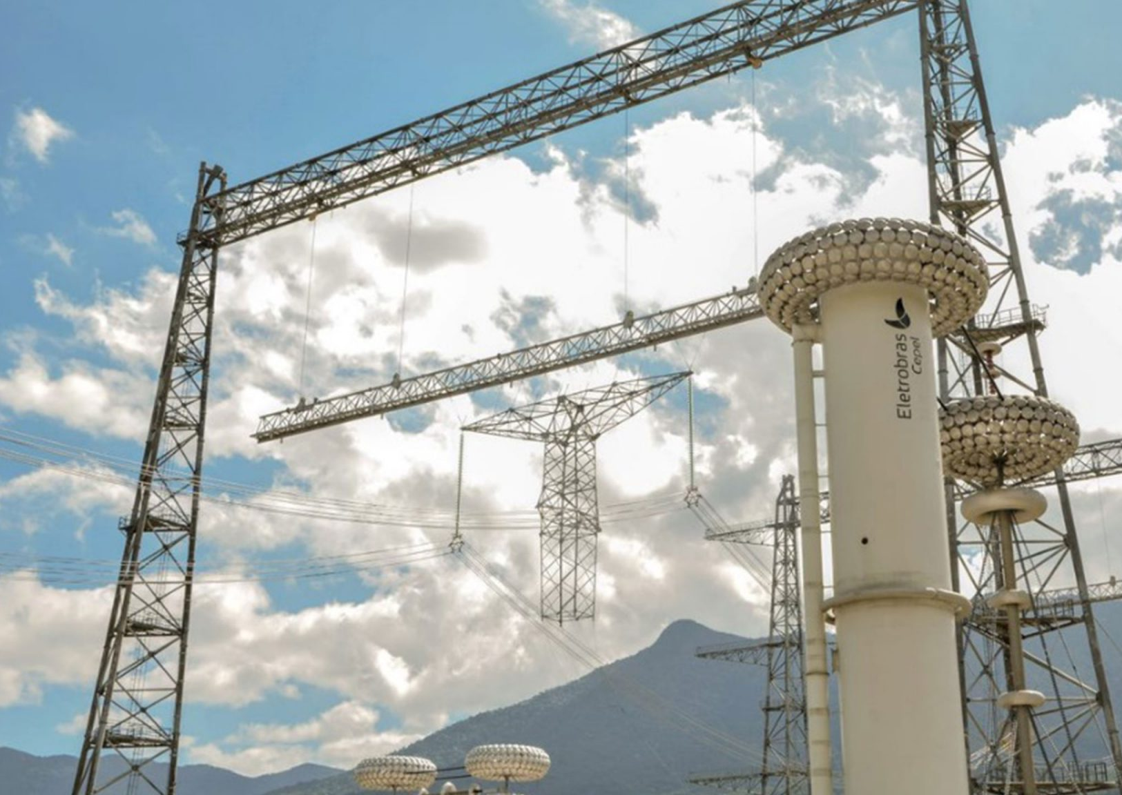
ULTRA HIGH VOLTAGE LABORATORY (LabUAT)
The ultra-high voltage laboratory, which is a part of the high voltage laboratory, is mostly used for experimental research.
Transmission lines and insulator equipment to be used on +1200kV AC or +1000kV DC are tested.
This laboratory is located in an open area.
All of the test can be performed dry and wet conditions.

Slide 27
The main tests carried out in this lab;
Withstand voltage (3-phase AC, DC, single phase AC),
Combined voltage,
Phase to phase isolation,
Corona effect.

Slide 28
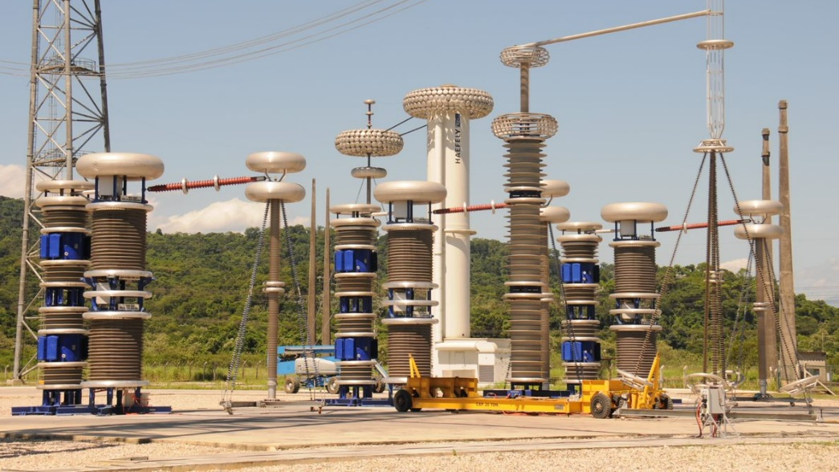
Ultra High Voltage Sources in Alternating Current

Slide 29
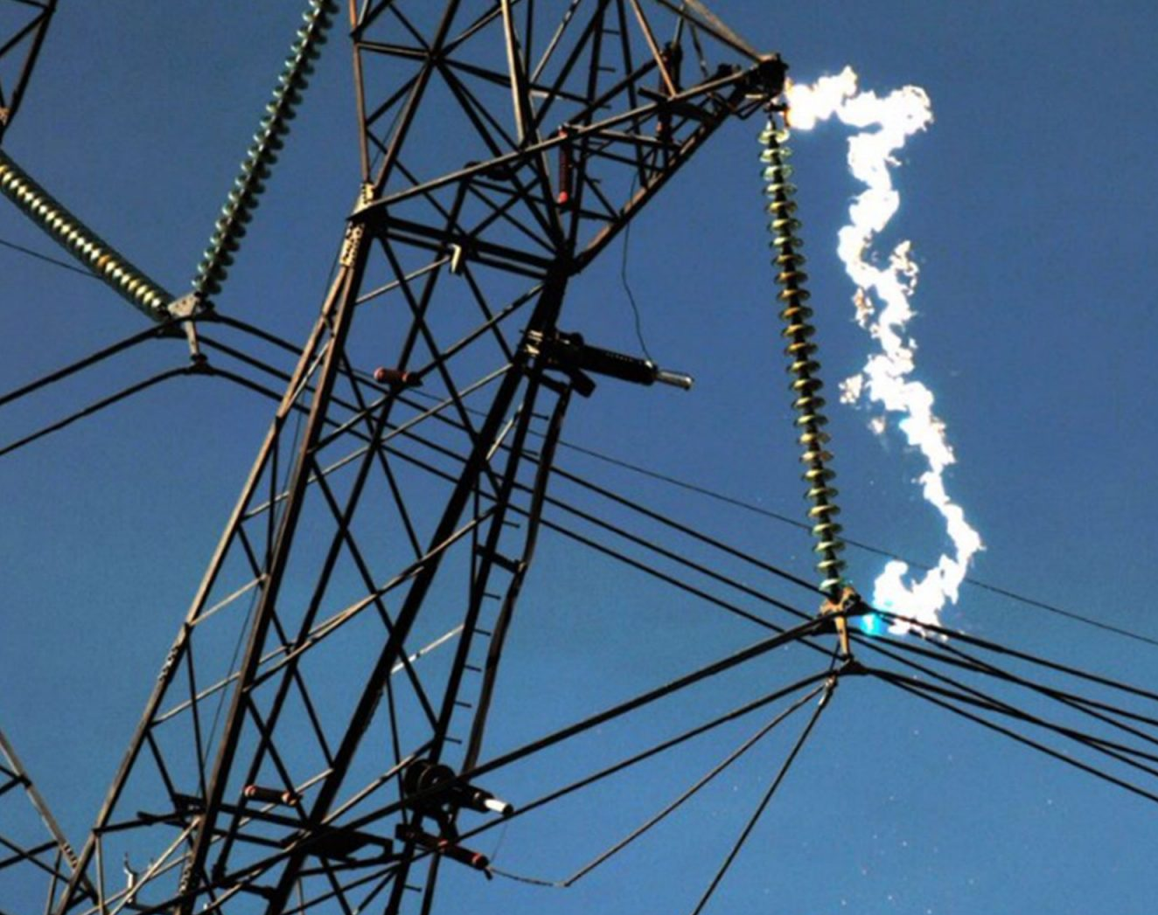
HIGH POWER LABORATORY
In the high-power laboratory, tests and configurations of certain equipment are carried out as in other laboratories.
Such tests serve to evaluate the electrical and thermomechanical performance of equipment and devices under normal or abnormal operating conditions, such as due or improper maneuvers, short circuits, and power arcs, among other events that may occur in service.

Slide 30
The main tests carried out in this lab;
Withstand short circuit,
Internal arcs,
Interruption of circuit breakers,
Defect currents,
Short circuits in transformers.

Slide 31
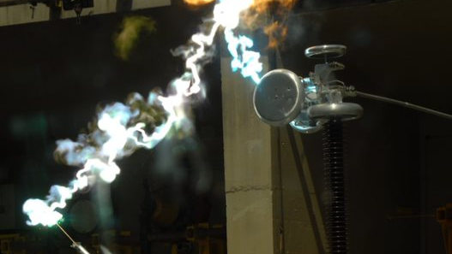
Test of induced current maneuvers in earthing switch

Slide 32

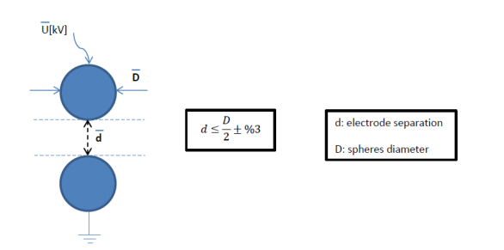
Step of the test
The sphere gap method of measuring high voltage is the most reliable and is used as the standard for calibration purposes.
Structure of spheres (metal-good conductor-should stand applied voltage)
Surface of spheres should be clean and smooth (no dust and polish)
Electrode separation (d) should be adjustable with ±%2 accuracy

Slide 33
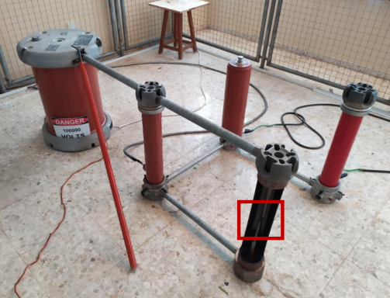

Insert the two spherical electrodes in the gap
Fix the distance between the two spherical electrodes
Turn on switches
Increase the primary voltage using the voltage regulator

Slide 34
Formulas and calculations done as part of the test
The measurement of high voltage using sphere gaps involves determining the breakdown voltage or the voltage at which electrical breakdown occurs in the gap between two spheres. The Paschen's Law is commonly used to estimate the breakdown voltage in sphere gaps.

Slide 35

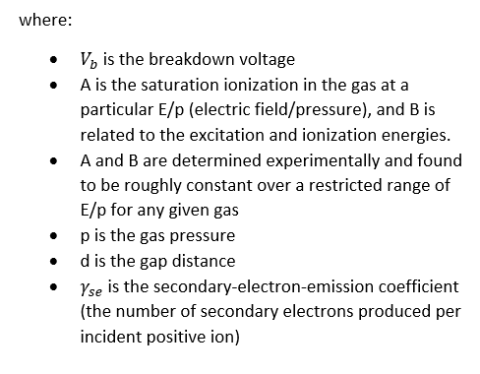
Paschen's Law relates the breakdown voltage (V) to the product of the gas pressure (P) and the gap distance (d) using the following equation:

Slide 36
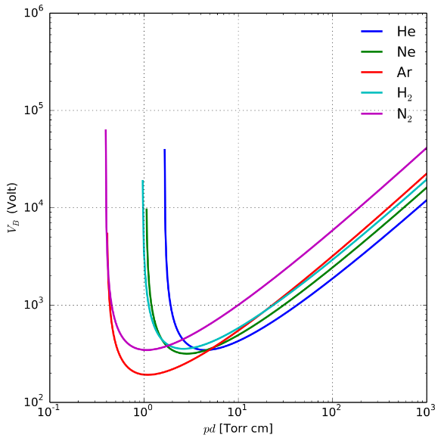
To perform the calculation, we need to know the gas pressure, the gap distance, and the specific value of the constant A and B for the given gas and electrode configuration. The constant A and B can be determined experimentally or obtained from published sources for commonly used gases.
Note: The actual breakdown voltage in practice may deviate from the values predicted by Paschen's Law due to various factors such as surface conditions, electrode shape, and gas impurities. Experimental verification and calibration are often necessary for accurate measurements.
Paschen curves obtained for helium, neon, argon, hydrogen and nitrogen, using the expression for the breakdown voltage as a function of the parameters A, B that interpolate the first Townsend coefficient.

Slide 37
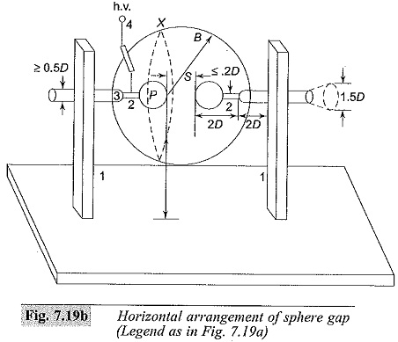
Which standards are followed during the tests?
During the measurement of high voltage with sphere gaps, there are several standards that are commonly followed to ensure accurate and reliable results. Some of the key standards of CEPEL that are often referenced in this field include:
ABNT NBR IEC 60060-1: This Brazilian standard, which is based on the international IEC 60060-1 standard, provides guidelines for high-voltage test techniques. It covers definitions, general requirements, test procedures, and measurement methods. CEPEL may refer to this standard for guidance.
IEC 60060-1: The international standard published by the International Electrotechnical Commission (IEC) offers guidance on high-voltage test techniques, including sphere gaps. It provides comprehensive information on the definitions, general requirements, test procedures, and measurement methods for high-voltage testing.

Slide 38
IEEE Std 4: Developed by the Institute of Electrical and Electronics Engineers (IEEE), IEEE Std 4 focuses on techniques for high-voltage testing. It provides information on test voltages, test circuits, and test procedures, which could be relevant to CEPEL's practices.
CIGRE TB 496: The guidance provided in CIGRE Technical Brochure 496, developed by the International Council on Large Electric Systems (CIGRE), on the measurement of very fast transient voltages with sphere gaps may be considered by CEPEL in specific testing scenarios.
These are some standards that are commonly followed in the field of high-voltage testing. However, for the precise standards and guidelines utilized by CEPEL in their tests, it is recommended to consult their specific publications, technical reports, or reach out to them directly for the most accurate and up-to-date information.

Slide 39
What are the results and fIndIngs of thIs test?
The measurement of high voltage with sphere gaps is a technique commonly used to assess the electrical insulation strength of high-voltage equipment. The results and findings obtained from such measurements can provide important information about the performance and integrity of the insulation system. Here are some of the key results and findings from measurements using sphere gaps:
1. Breakdown Voltage: The primary result obtained from a sphere gap measurement is the breakdown voltage. This refers to the voltage level at which a spark or breakdown occurs across the gap. The breakdown voltage is an indicator of the dielectric strength of the insulation system being tested. It represents the voltage at which the insulation begins to break down and electrical discharge occurs.

Slide 40
2. Withstand Voltage: The withstand voltage is the maximum voltage that the insulation can sustain without breaking down or experiencing electrical discharge. By gradually increasing the voltage across the sphere gap, measurements can determine the maximum voltage that can be applied without causing breakdown. The withstand voltage provides an indication of the insulation's ability to handle high voltage stress and maintain its integrity.
3. Creepage Distance: Sphere gap measurements can also help assess the creepage distance of insulating surfaces. Creepage distance refers to the shortest path along the surface of the insulator between two conductive parts. It is an important parameter for ensuring appropriate insulation spacing to prevent electrical arcing and breakdown. Sphere gap measurements can help determine if the creepage distance meets the required safety standards.
4. Corona Effects: Sphere gaps can exhibit corona discharge when the applied voltage exceeds a certain threshold. Corona discharge produces localized ionization, ozone generation, and electrical noise. By observing the occurrence and characteristics of corona effects during sphere gap measurements, it is possible to assess the insulation's susceptibility to corona and make necessary design or maintenance adjustments to mitigate its impact.
5. Comparative Testing: Sphere gaps can be used for comparative testing of different insulating materials or configurations. By measuring breakdown voltages with different materials or arrangements, it is possible to compare their insulation performance and identify the most suitable option for a specific application.

Slide 41
Are there any software or dIgItal tools used In thIs lab? For whIch actIvItIes are they used?
1. Power System Simulation Software: Software tools like PSS®E, PSCAD/EMTDC, DIgSILENT PowerFactory, and EMTP-RV are commonly used for modeling, simulating, and analyzing power systems, including load flow analysis, transient stability analysis, and electromagnetic transient analysis.
2. Power System Analysis Tools: Tools such as ETAP, CYME, and PowerWorld Simulator provide capabilities for power flow analysis, short circuit analysis, protective device coordination, and voltage stability analysis.
3. Protection Relay Testing Software: Software tools like Omicron Test Universe, Doble Protection Suite, and Megger SVERKER Win are used for testing, analyzing, and calibrating protection relays, including relay coordination analysis and relay simulation.

Slide 42
4. Electromagnetic Field Simulation: Software tools such as ANSYS Maxwell, COMSOL Multiphysics, and CST Studio Suite are utilized for electromagnetic field simulation and analysis in power system components, including transformers, insulators, and transmission lines.
5. Data Acquisition and Analysis: Tools like LabVIEW, MATLAB, and Python (with libraries like NumPy and SciPy) are commonly used for data acquisition, processing, and analysis in electrical engineering laboratories.
6. SCADA Systems: Supervisory Control and Data Acquisition (SCADA) software is used for monitoring and controlling power systems, data acquisition, and real-time visualization.

Slide 43
https://faraday.emu.edu.tr/eeng451/Experiment%202.pdf http://www.faadooengineers.com/online-study/post/eee/high-voltage-engineering/127/sphere-gap http://relatorioanual2020.cepel.br/en/laboratory-infrastructure.html https://www.cepel.br/ http://www.faadooengineers.com/online-study/post/eee/high-voltage-engineering/127/sphere-gap https://faraday.emu.edu.tr/eeng451/Experiment%202.pdf https://www.inmrlaboratoryguide.com/listing/electrical-energy-research-center/ https://www.eeeguide.com/sphere-gaps-are-used-to-measure-voltage-measurement/#:~:text=A%20sparkover%20voltage%20of%2030,or%20any%20uniform%20field%20gap. https://www.allcivilstandard.com https://pe2bz.philpem.me.uk/Power/-%20-%20Power-Design%20-%20-/HighVoltage/sphgap.htm https://en.wikipedia.org/wiki/Paschen%27s_law
References

